Slide 1
Super store data analysis
MOHAMMED SUHAIL M R
ADVANCED EXCEL PROJECT

Slide 2
INTRODUCTION
Superstore analysis is to identify the performance trend's, including product ID, Order ID , Segment's, and over view of the sales and the discounted price and the profit.
The aim is to optimize marketing strategies by focusing on high-performing products, optimize sales channels, and enhance operational efficiency, enabling stakeholders to make informed decisions and focus on areas of growth, ensuring data-driven decisions to maximize profitability, improve overall business performance and market expansion.

Slide 3
DATA UNDERSTANDING
No OF ROW’S : 9995
No OF COLUMNS : 21
No OF COLUMNS AFTER COLUMNS : 23
NO DUPLICATE VALUE’S
NO NEGATIVE SALES

Slide 4
Work flow
DATA IMPORTING
DATA CLEANING
CHECKING MISSING VALUES
WHATIF ANALYSIS
PIVOT TALBE ANALYSIS
CREATING DASHBOARD
macro.xlsm

Slide 5
DATA SET

Slide 6
DATA CLEANING
There is no missing values in the data
There is no duplicates
And there is no negative values

Slide 7
Formulas and whatif analysis

Slide 8
Formulas and whatif analysis

Slide 9
Pivot table analysis

Slide 10
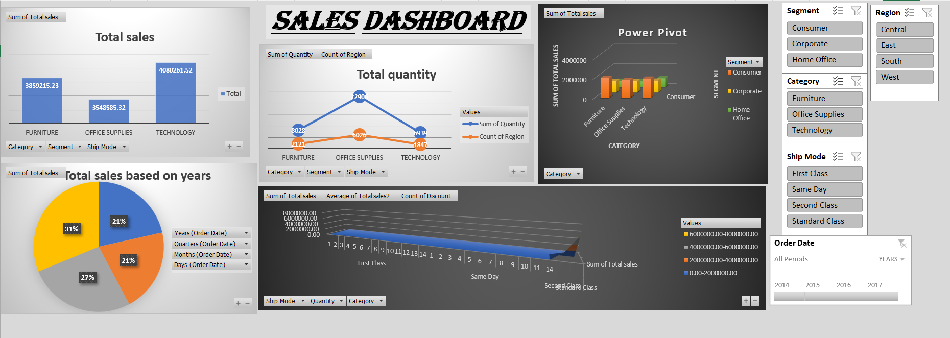
Dashboard

Slide 11
Conclusion
KEY TAKEAWAYS :
The dashboard reveals strong performance in Funiture.
Opportunities exist to enhance customer satisfaction by increasing the sale's in other region.
Marketing and operational efforts should focus on high-performing regions .
RECOMMENDATIONS :
Focus on high-sales states and expand to weaker regions.
There should be the focus on the furniture part in the home office segment.
FUTURE CONCIDERATION :
Conduct customer service to gather feedback on product offerings, service experiences and customer preferences to personalize products.

